Slide 1





JoJo Technology -
Iteration 1
Group Member: Amy Nguyen, Zhuoyue Sun, Jiahao Zhang, Xiaocheng Kang

Slide 2
Member Introduction
Project Manager: Amy Nguyen
Technical Manager: Zhuoyue Sun
Developers: Jiahao Zhang and Xiaocheng Kang

Slide 3


1.
UML Diagrams
Presenter: Zhuoyue Sun

Slide 4
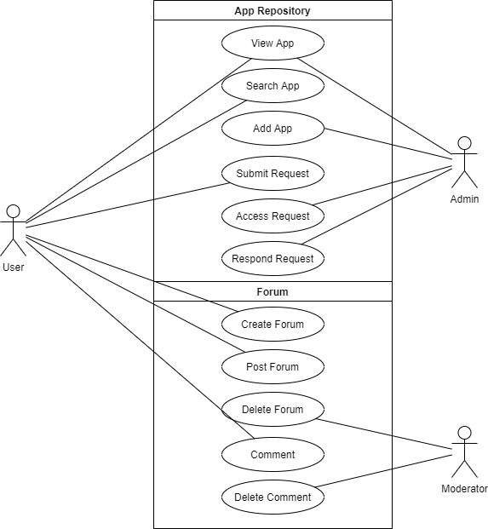
Use Case Diagram

Slide 5
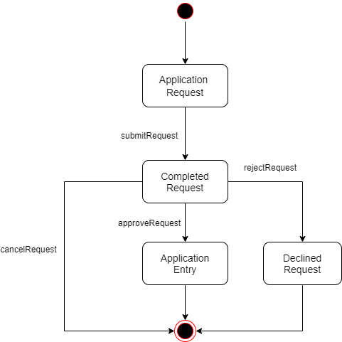
Application State Diagram

Slide 6
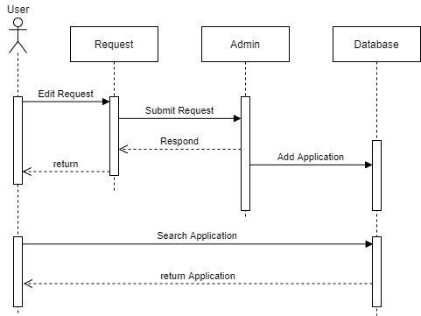
Sequence Diagram

Slide 7

2.
Burn down Chart
And Task Board
Presenter: Jiahao Zhang

Slide 8
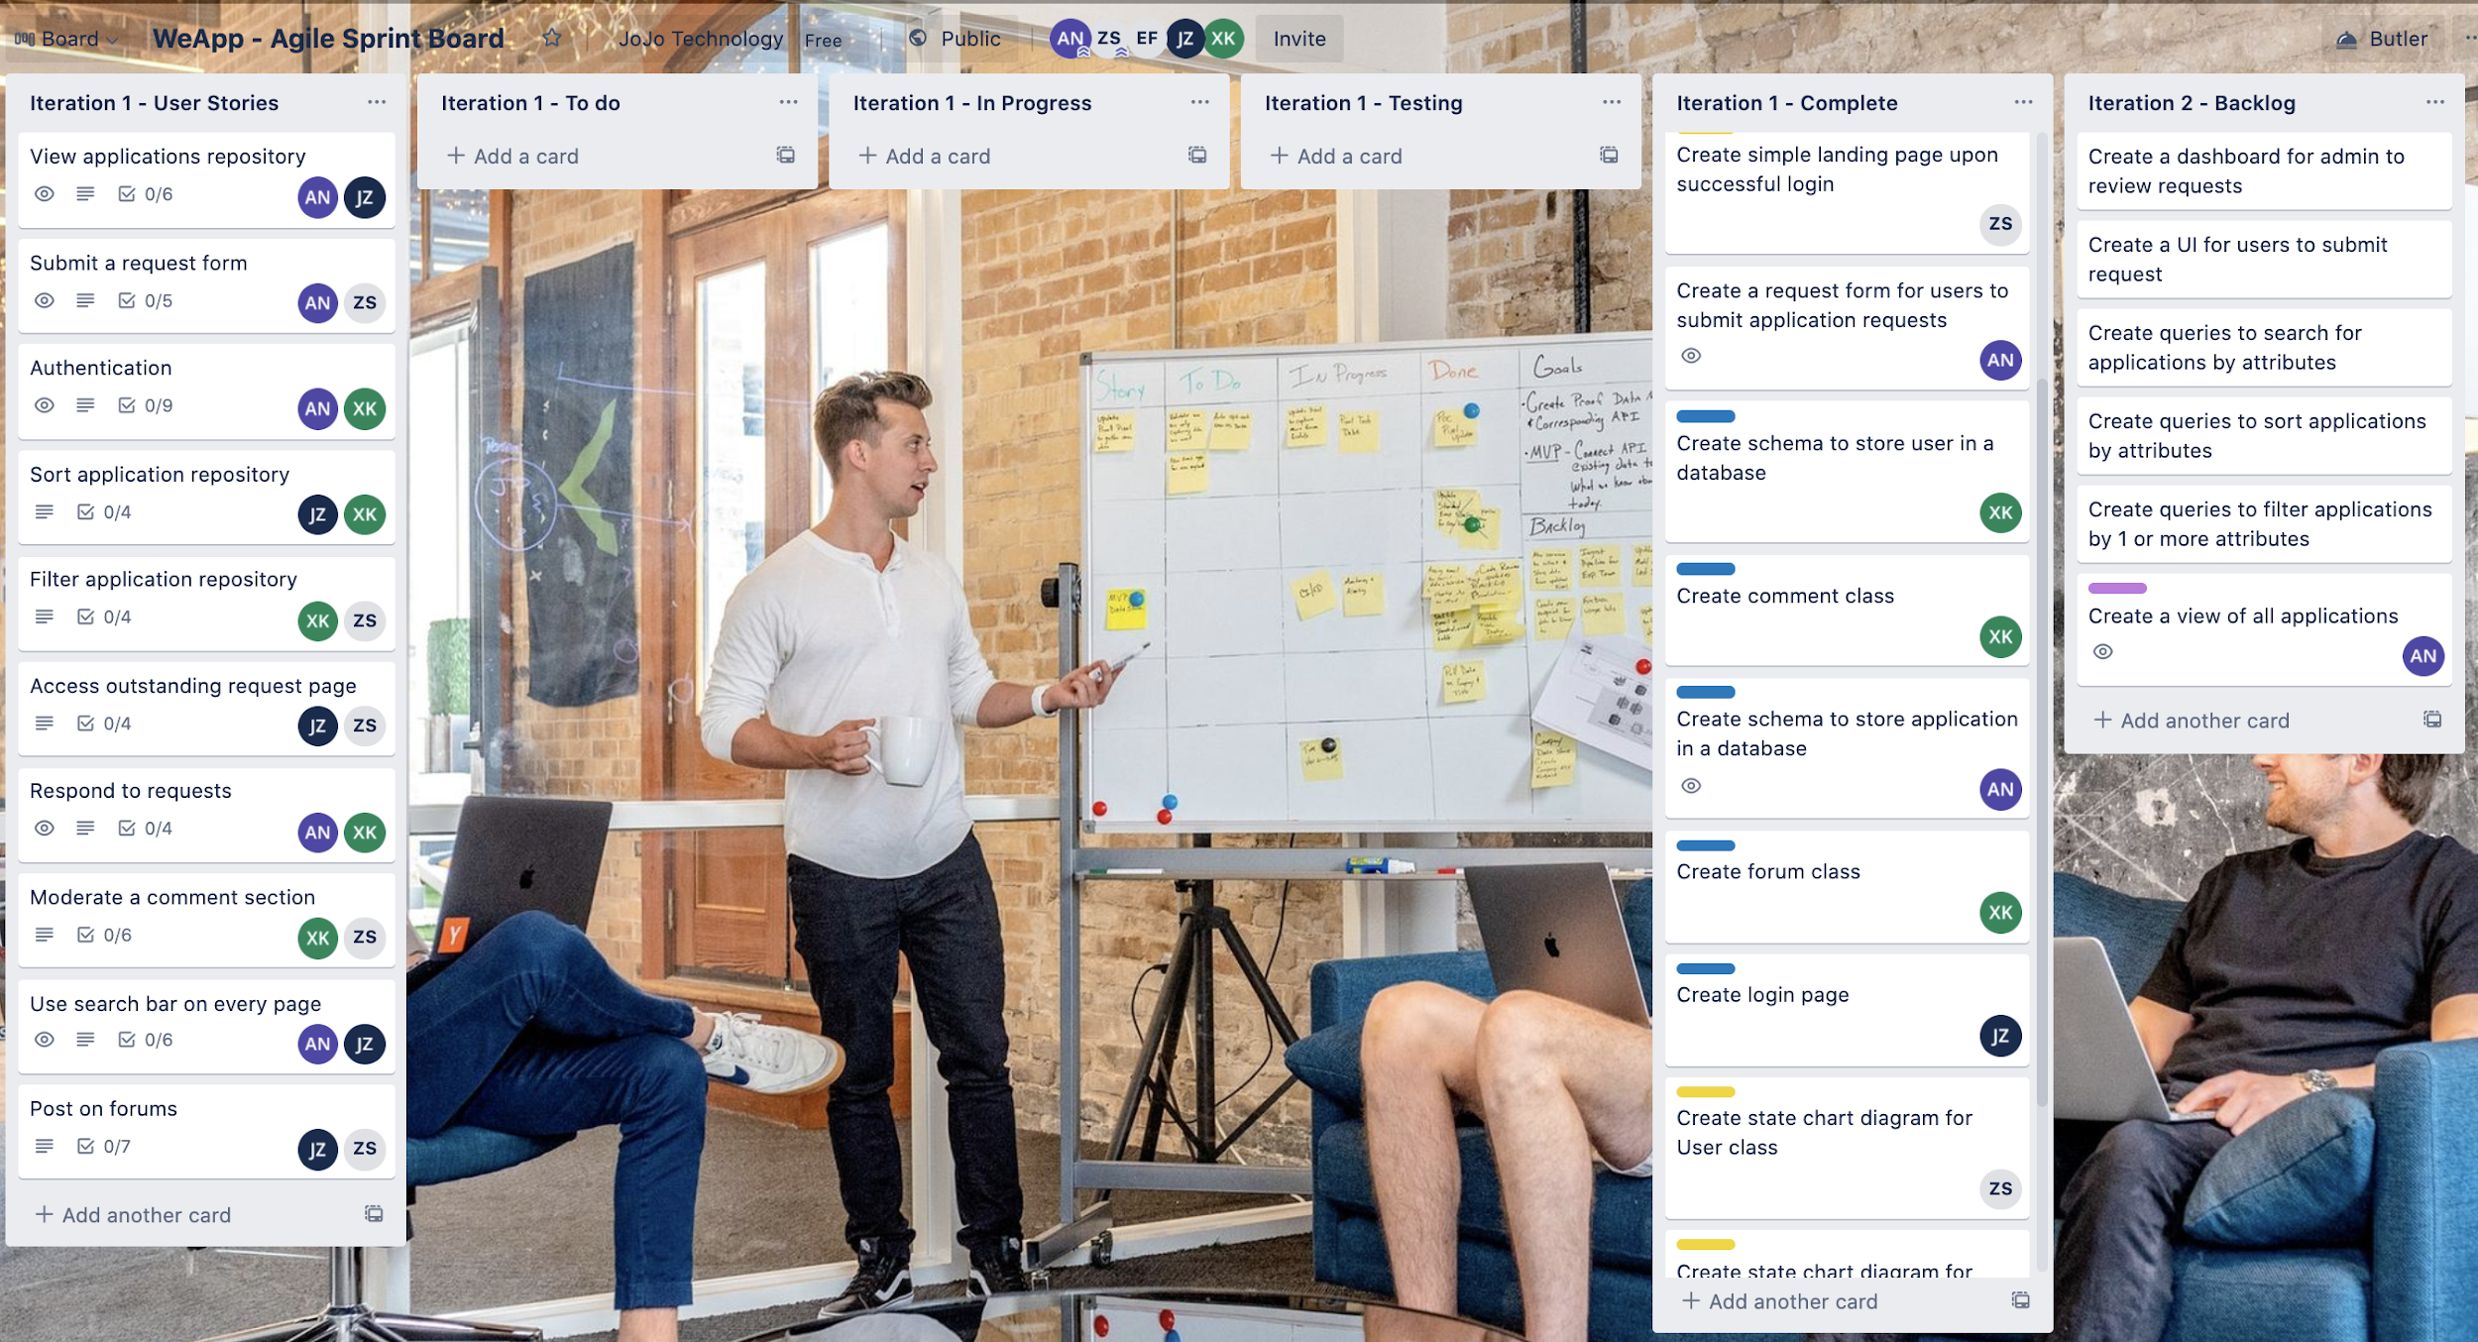
Trello Task Board

Slide 9
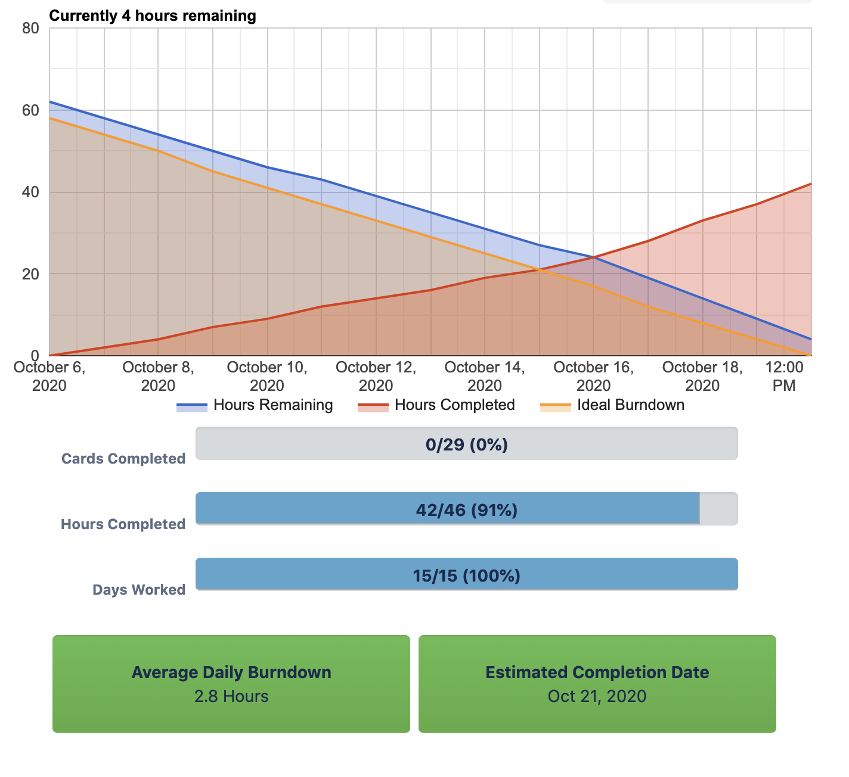
Burndown Chart
Our velocity is around 0.75
Total hours estimated for this iteration 46 hours
Days worked: 15 days
At the beginning, velocity is
We spend an average of 2.8 hours per day in this iteration
At the end of our iteration, we still have 4 hours remaining and this is because we have yet to finish the user interface list view of applications (we are about halfway done with this task)

Slide 10








3. Working
Web App & progress
Presenter: Amy Nguyen

Slide 11
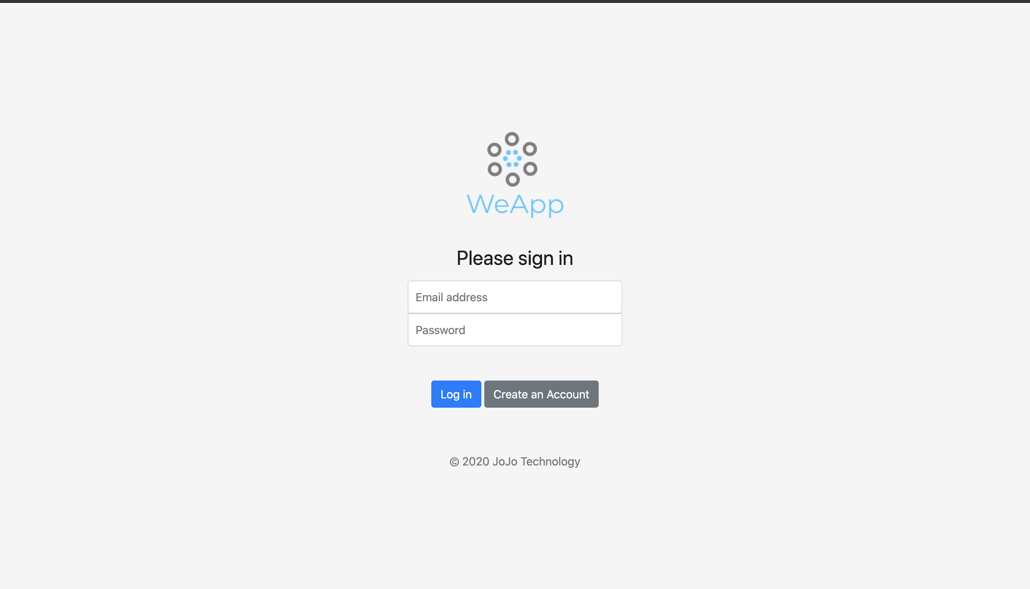
Login Screen

Slide 12
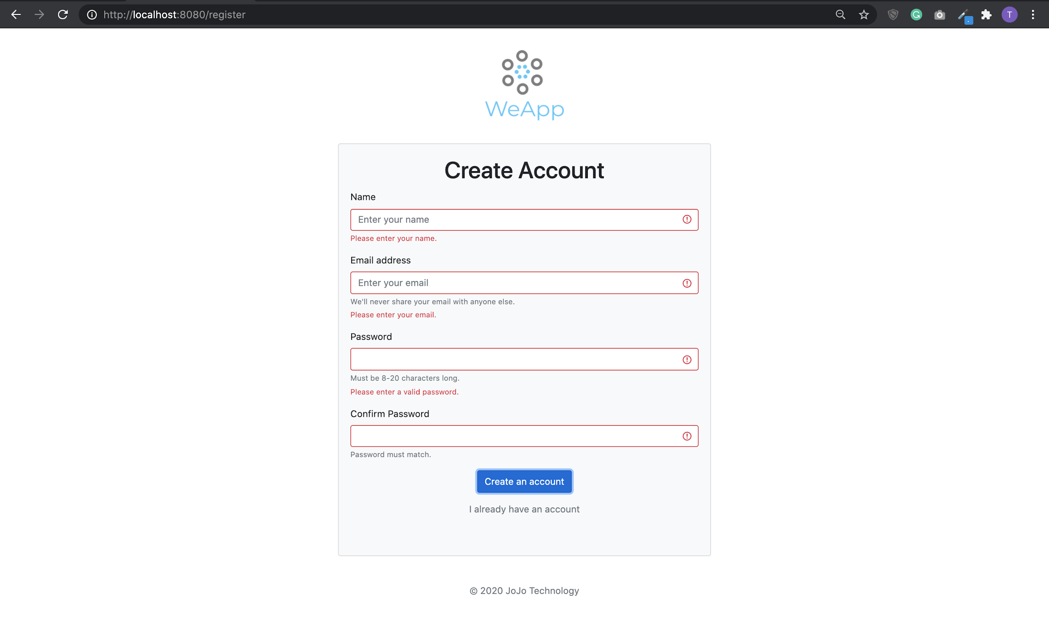
Submit without filling out all the field (client-side validation with Bootstrap)

Slide 13
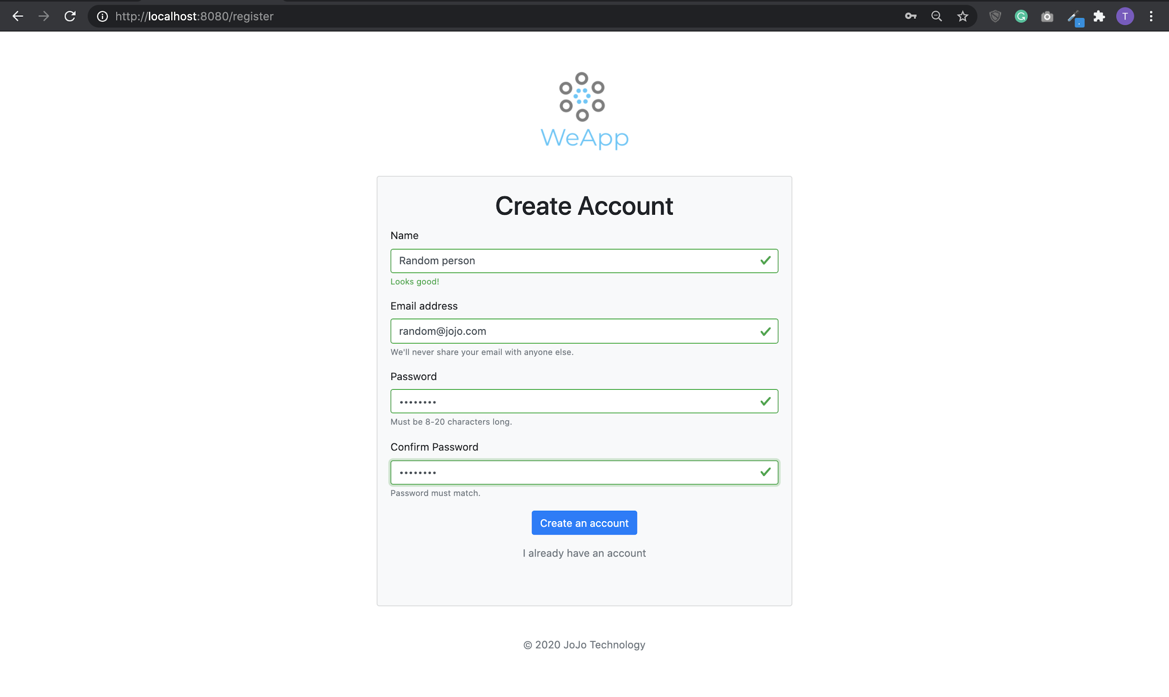
When all fields are filled out and passwords match. Click on ‘Create an account’, it submit the form, store new user in database, and redirect to login page.

Slide 14
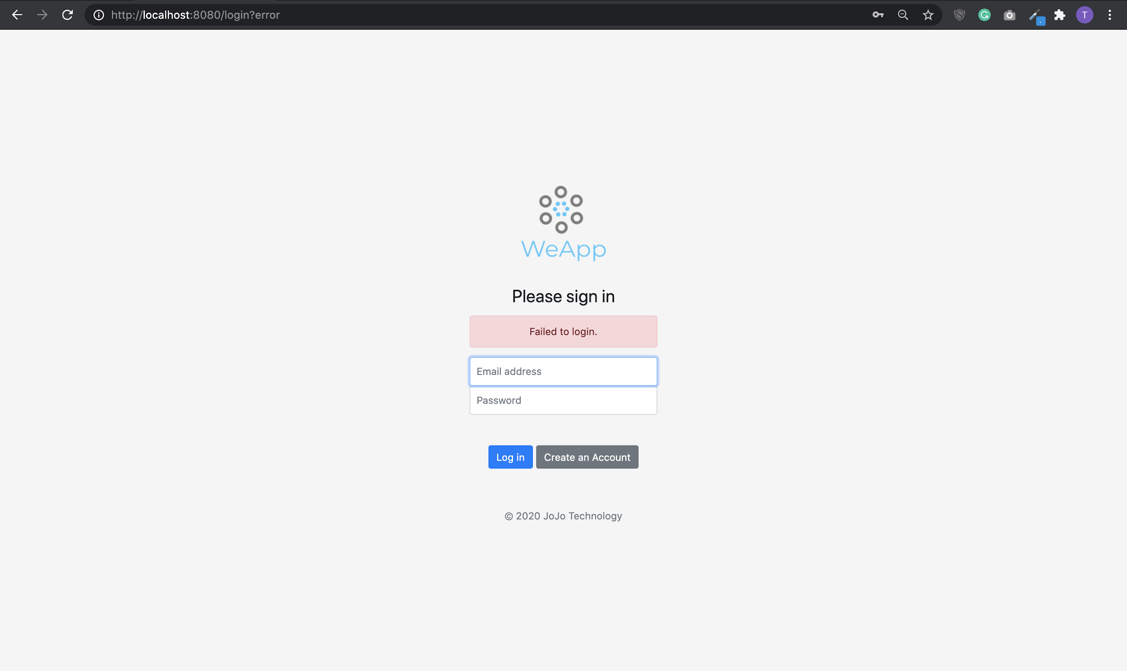
Input the wrong combination of username and password (leveraging authentication with Spring Security)

Slide 15
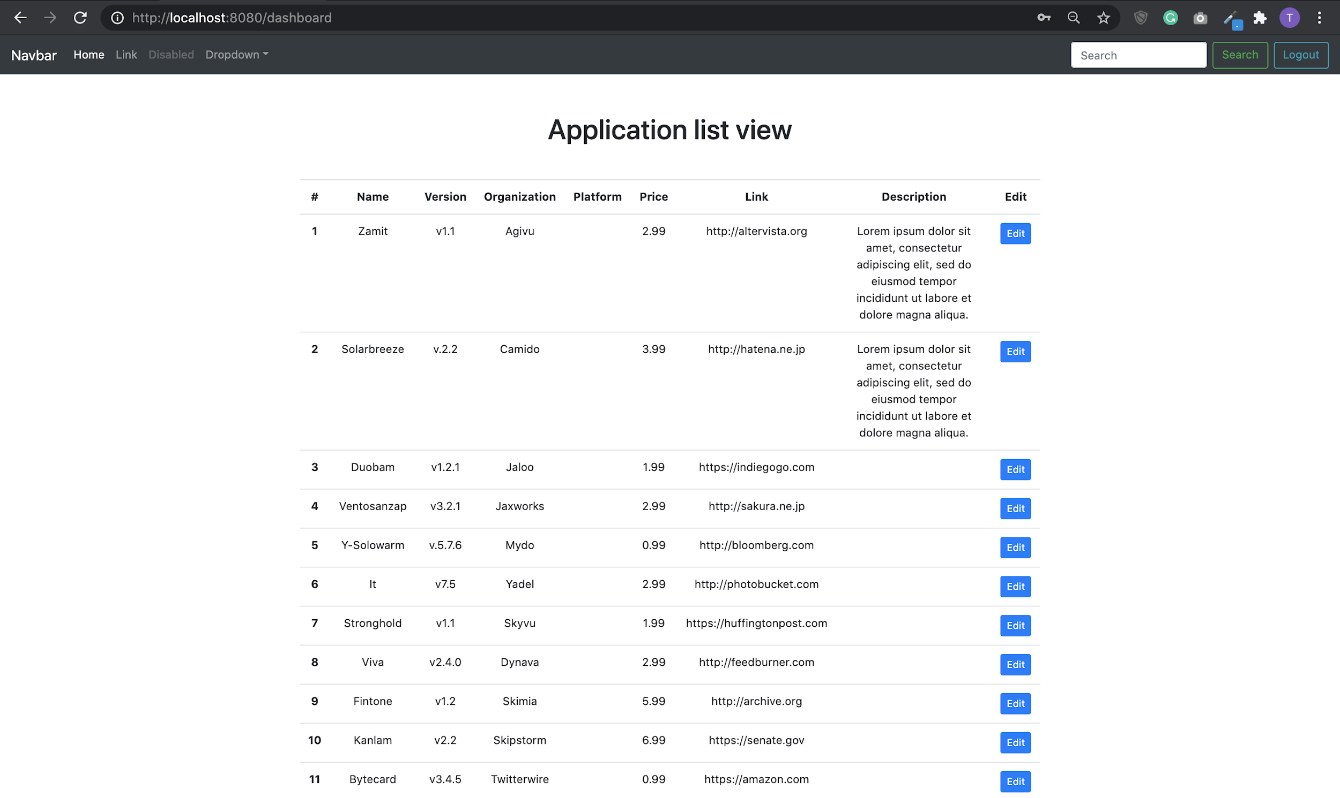
List View of Applications (table populated with data from local MySQL database)

Slide 16
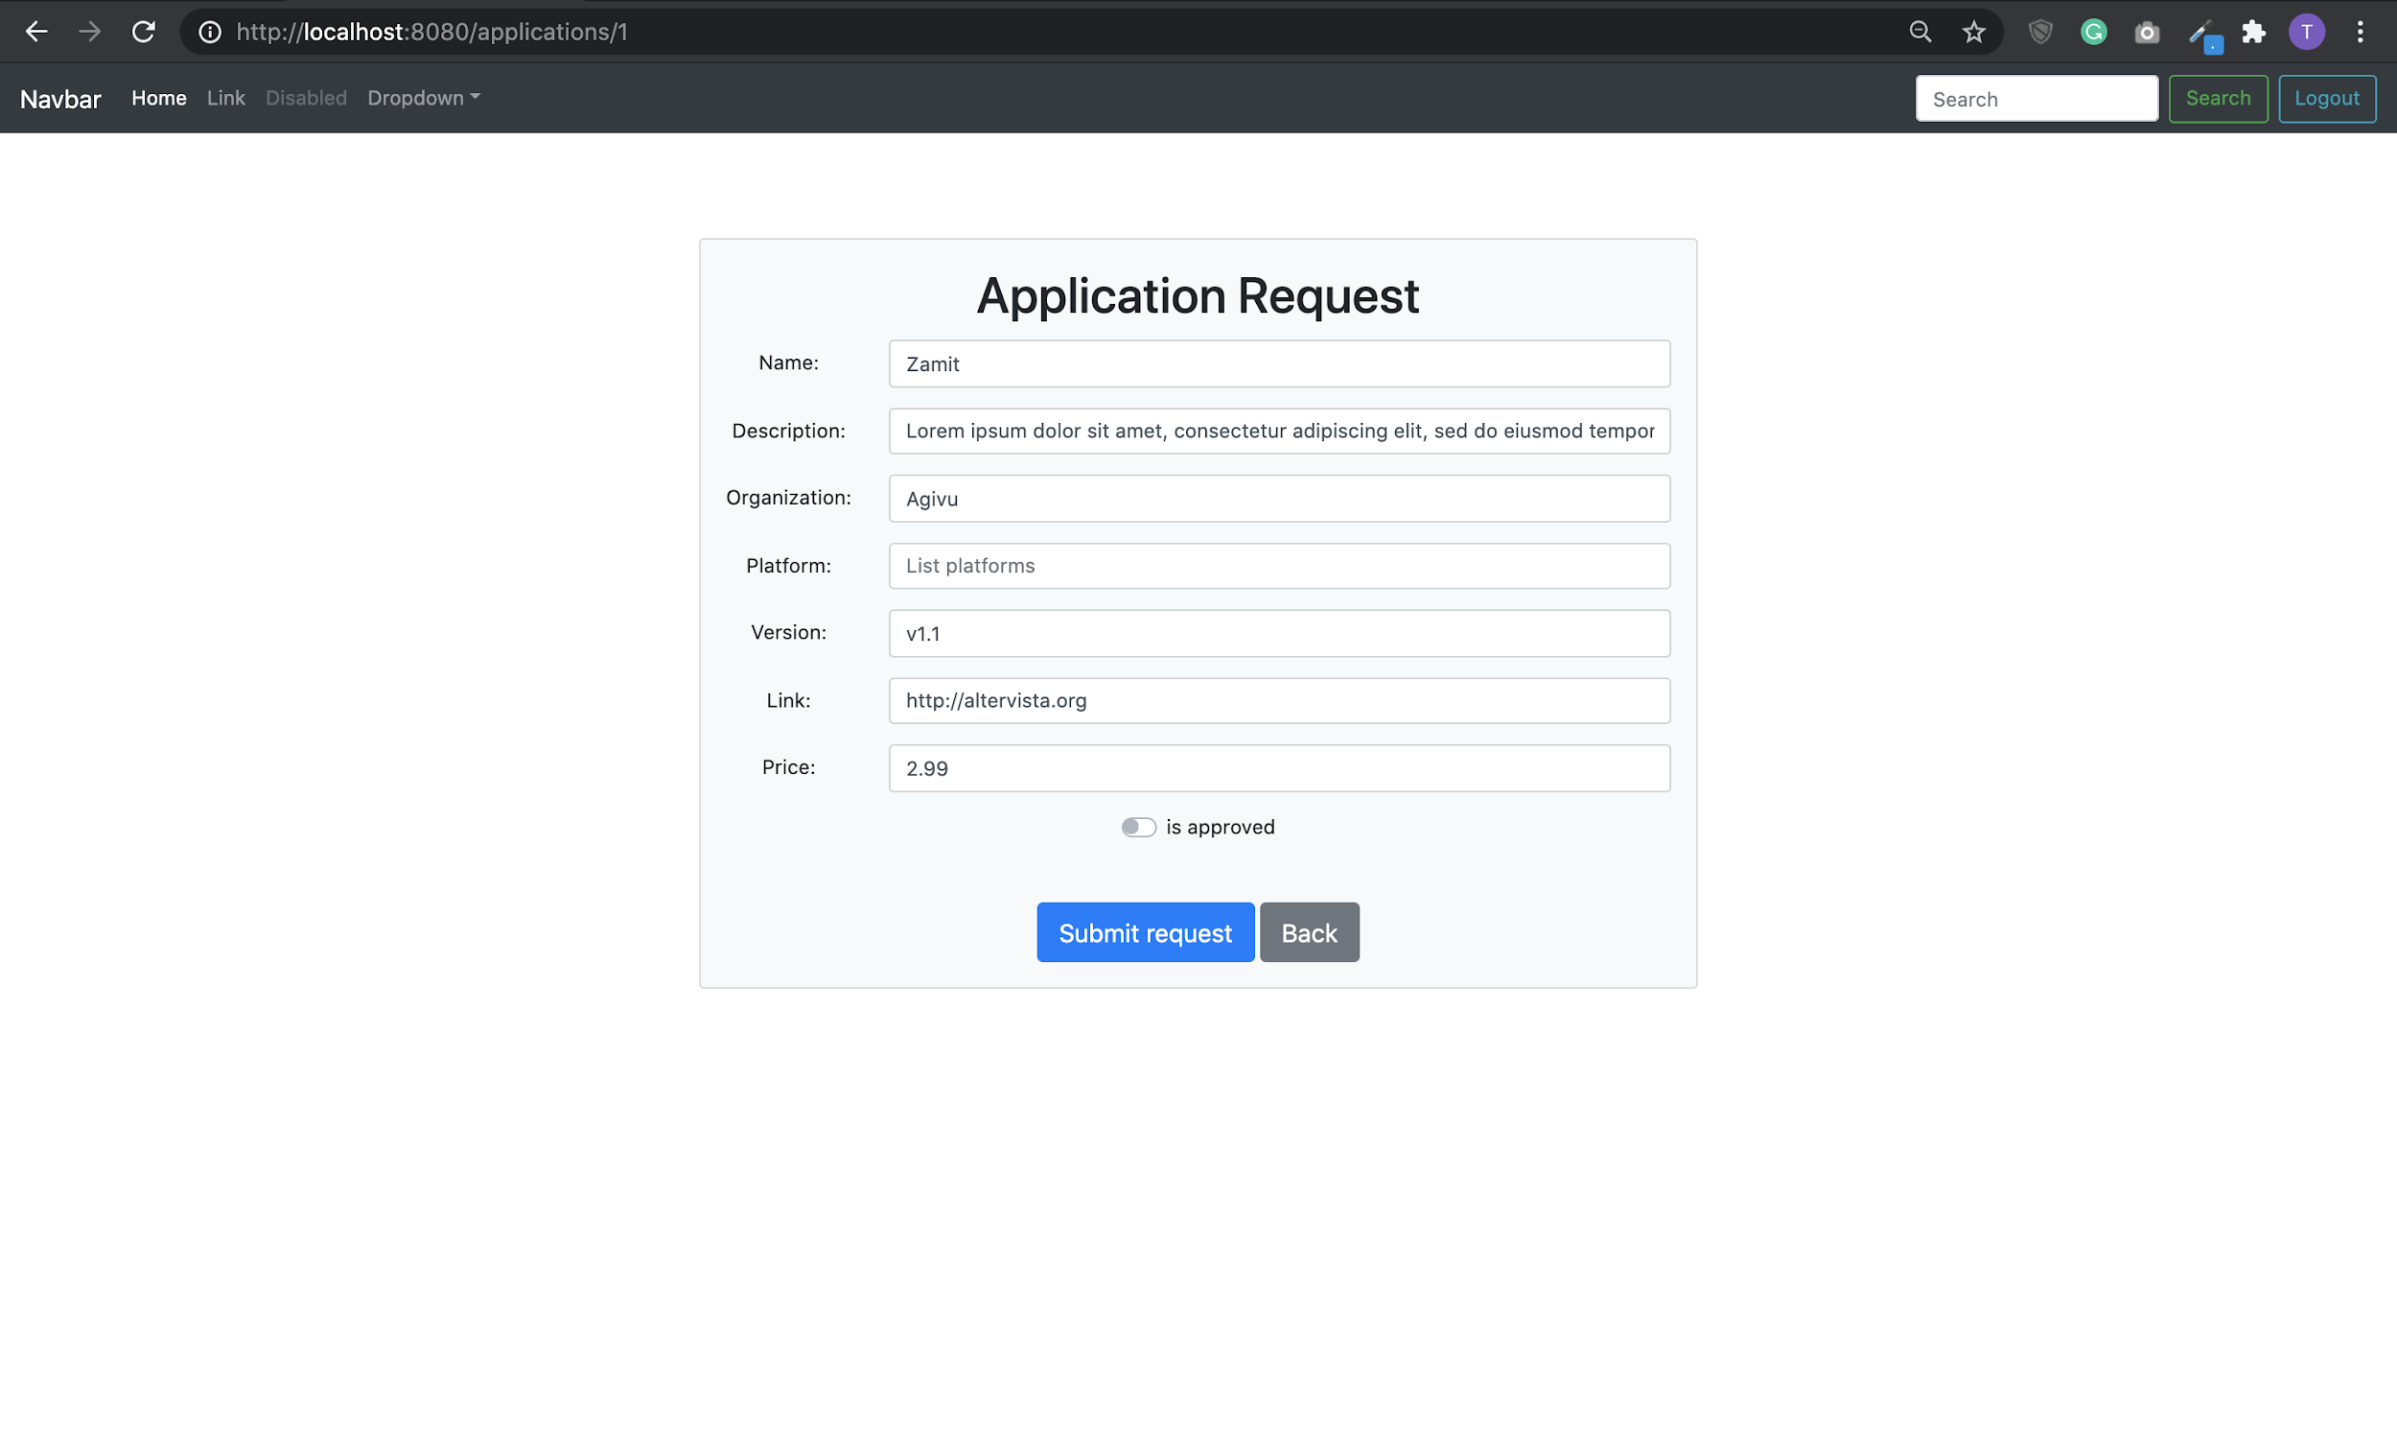
Application Request form populated with data from local MySQL database if application entry exists

Slide 17
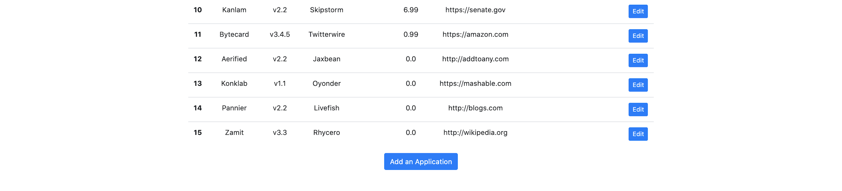
‘Add an application’ button directs to Application Request Form

Slide 18
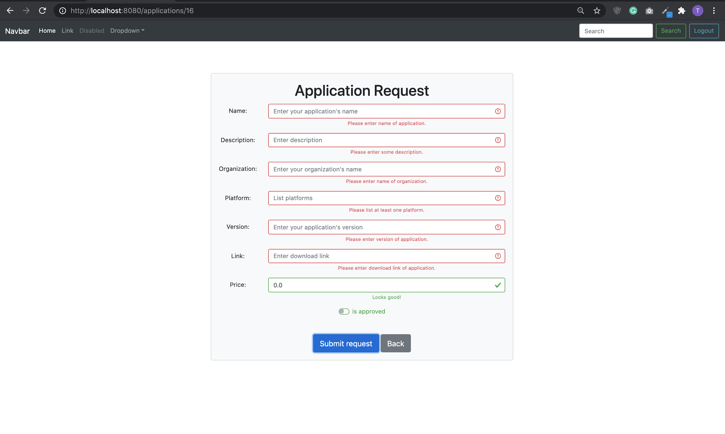
Submit request without filling out all fields. An app’s price can be 0.0 (Free!)

Slide 19
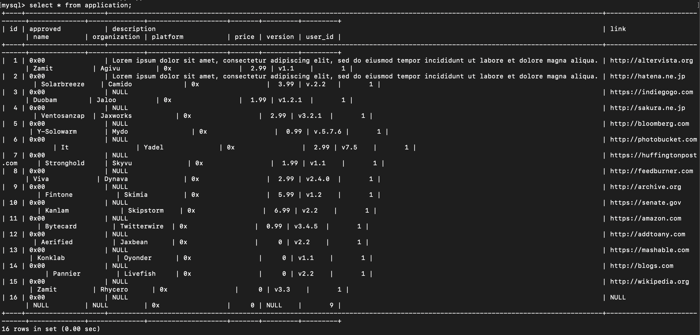
View of our application table in the local MySQL database

Slide 20
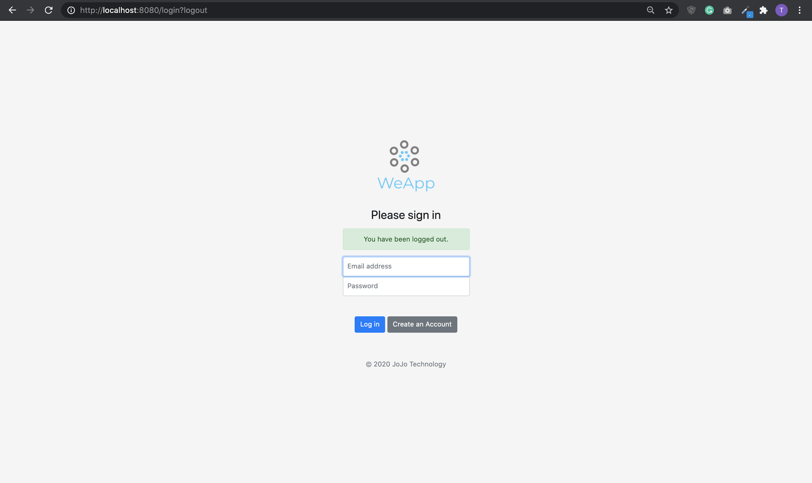
Logout screen

Slide 21
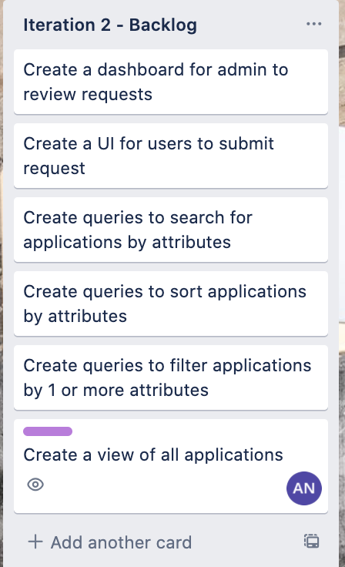
Tasks/stories push back to Iteration 2
Create a simple view of all applications is pushed to Iteration 2 because it is incomplete because of the mapping of web pages based on user’s authority level
Will meet with customer this Friday to confirm requirements/tasks for Iteration 2 and distribute tasks
Still have more unit tests to be done

Slide 22
4.
Retrospective
Presenter: Xiaocheng Kang

Slide 23
What went well?
All member contributes to the code repository and documentation
Working web applications and complete 91% of taks/stories planned for iteration 1
Internal meeting that takes place once a week and fair distribution of tasks
Productive customer meeting with TA Evan each week

Slide 24
What didn't?
Velocity of work at the beginning of iteration is slow because of mid term week but we pick up the pace in the second half of iteration 1
Initial problem with setting up Spring project in Eclipse but problem was resolved by installing Spring plug-ins
Unfamiliarity with Github at the start but topic was covered in class later

Slide 25
Open challenges and action plans
Problem 1: Leveraging the project with new technologies
Each member spend time to read more documentation
Distribute tasks based on member’s strengths, weaknesses, and interests
Problem 2: Working with Github
Use Git in a more efficient and productive manner by implementing a Git workflow
Manage development by creating a branch for every big feature

Slide 26

Thanks!
Any questions?
Have a great week!

